Slide 1
Introduction to infectious disease epidemiology
Cristina Lanzas
CBS 810 Infectious disease modeling
2015

Slide 2
Learning objectives
Describe the classification of infectious diseases relevant to modeling
Describe the differences between the timeline of disease and infection
Recognize the different epidemiological disease patterns
Define the epidemiological measures of transmission

Slide 3
Infectious disease & agents
An infectious disease is a disease that is caused by the invasion of a host by agents whose activities harm the host's tissues (that is, they cause disease) and can be transmitted to other individuals (that is, they are infectious).
Agents
Prions
Virus
Bacteria
Fungi
Protozoa
Helminths
Arthropods

Slide 4
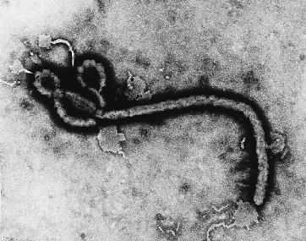
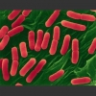
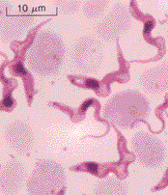
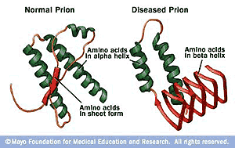
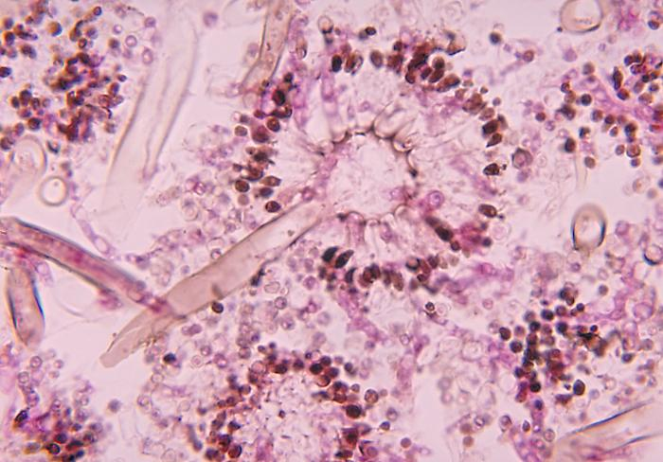
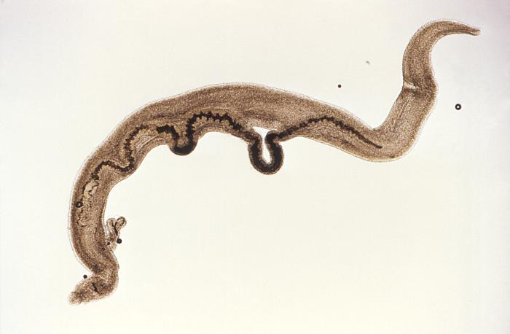
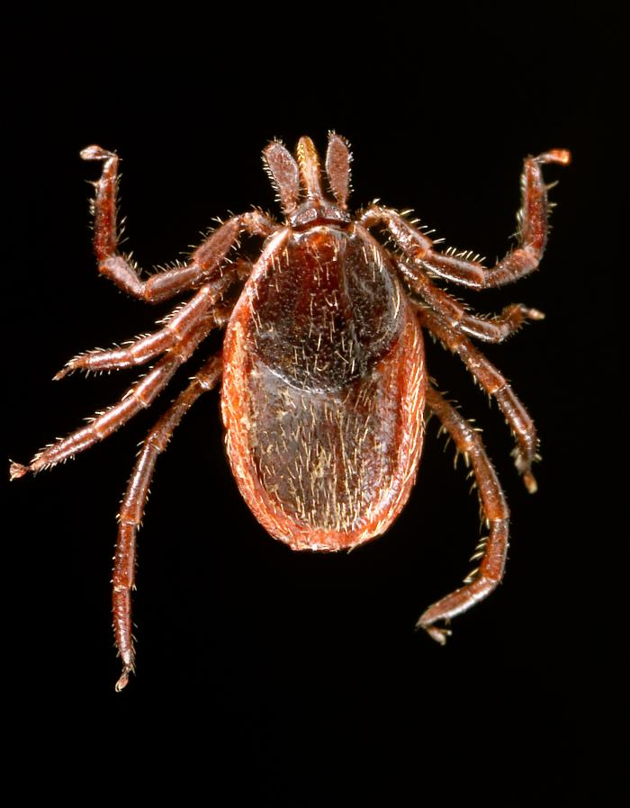
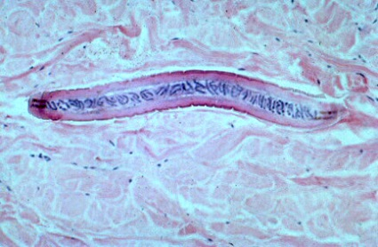
Classification of infectious agents
MICROPARASITES
Ebola virus
Virus
Protozoa
Bacteria
Trypanosoma
Prions
Fungi
Escherichia coli O157
Aspergillus
MACROPARASITES
Trematodes
Nematodes
Ectoparasites
Schistosoma mansoni
western blacklegged tick
Mansonella streptocerca

Slide 5
Microparasites
Short generation times relative to the hosts
Multiply within host
Reach large populations within host (e.g. H1N1 Viral Load: 10⁸ virions/mL of respiratory secretion)
Unit of interest: Host (infection and immune status)
Susceptible
Infectious
Recovered

Slide 6
Model for microparasites
Host population is subdivided into broad compartments based on infection and immune status.
Susceptible
Infectious
Recovered

Slide 7
Macroparasites
Specialized infective stages and complex life cycles
Do not multiply within the host, reproduce and release eggs or larvae into the environment
Host morbidity depends on burden
Unit of interest: Host parasite burden

Slide 8
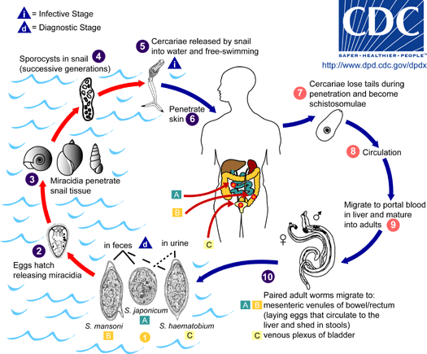
Schistosoma

Slide 9
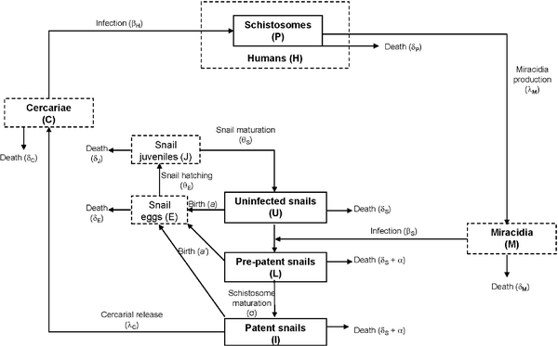

Figure 1. Schematic diagram of the schistosome disease model.
Mangal TD, Paterson S, Fenton A (2008) Predicting the Impact of Long-Term Temperature Changes on the Epidemiology and Control of Schistosomiasis: A Mechanistic Model. PLoS ONE 3(1): e1438. doi:10.1371/journal.pone.0001438
http://www.plosone.org/article/info:doi/10.1371/journal.pone.0001438

Slide 10
Timeline of infection and disease
Disease is a process that unfolds over time
Natural history – sequence of developments
Medicine: Natural history of the disease
Public health: Natural history of the infection

Slide 11
Disease timeline
Time of infection
Appearance of symptoms
Resolution of infection
Incubation period
Symptomatic period

Slide 12
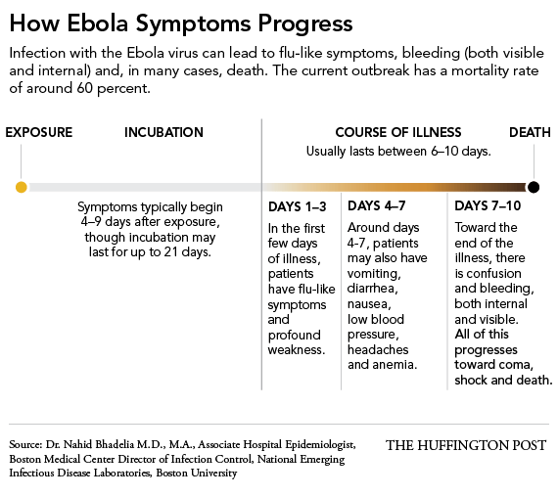
Disease timeline for ebola

Slide 13
Infection timeline
Time of infection
Infection transmittable
Infection not transmittable
Susceptible
Exposed
Infectious
Recovered
Latent period
Infectious period

Slide 14
From a public health perspective, would you say that it is better the latent period be shorter than the incubation period or vice versa? Why?

Slide 16
Modes of transmission
Touching
Sexual intercourse
Biting
Direct projection of droplets
Transplacenta
Direct transmission
(host-to-host)
Indirect transmission
Airborne
Vehicle-borne
Vector-borne

Slide 17
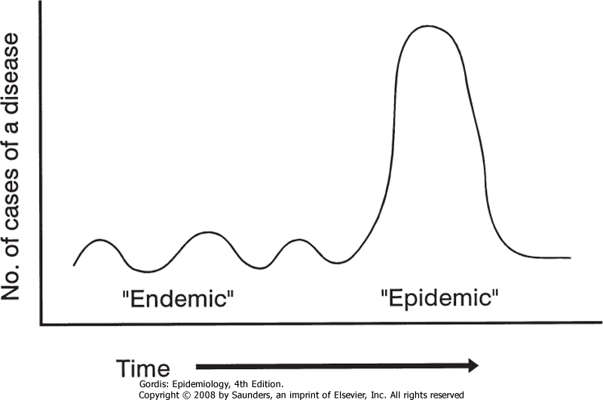
Epidemiological temporal patterns
Epidemic A rapid increase in the levels of an infection beyond what is expected for a given time and place.
Endemic: levels of infection do not exhibit wide fluctuations through time in a defined place.

Slide 18
Endemic patterns
Stable endemicity: the incidence of infection or disease shows no secular trend for increase or decrease.
Endemic cycles: Cycles can occur because of:
Seasonal variations
Herd immunity building up and then dropping off (“epidemic cyclicity”)
Patterns of activity (“School terms, holidays”)

Slide 19
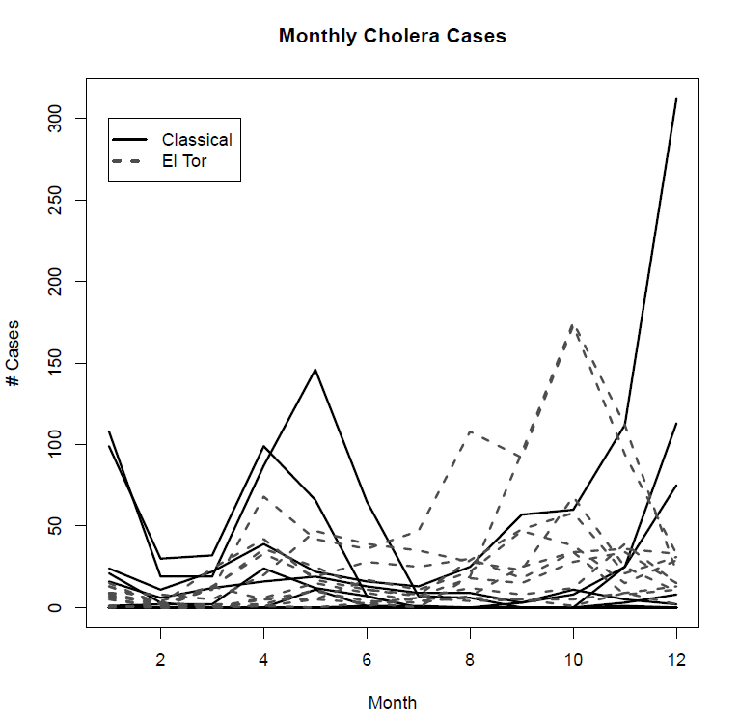
Seasonal variations
Ruiz-Moreno, BMC Infectious diseases, 10: 51 (2010)

Slide 20
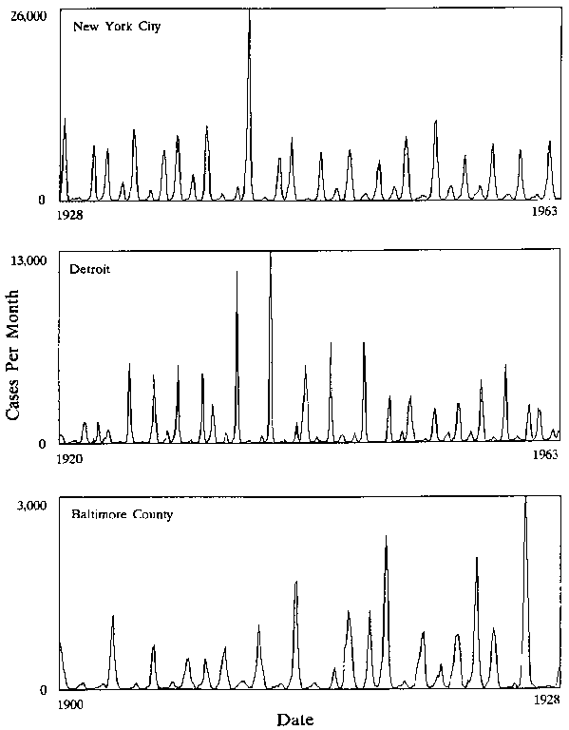
Recurrent measles epidemics
Monthly reported cases of measles in three North American cities (Sources: New York City data from Yorke and London (1973); Baltimore County data from Hedrich (1933))

Slide 21
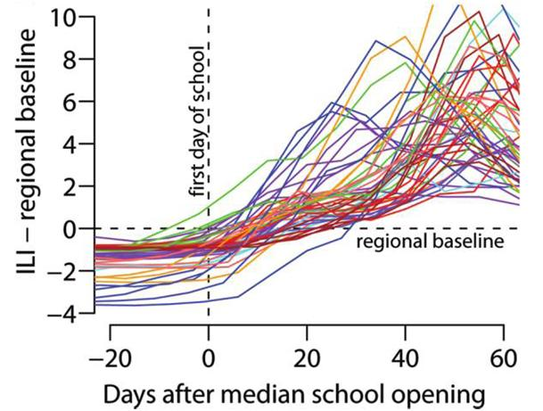
Patterns of activity
Weekly percentages of influenza-like illness by state, relative to school opening dates
Chao et al. J Inf Dis, 202:877-880 (2010)

Slide 22
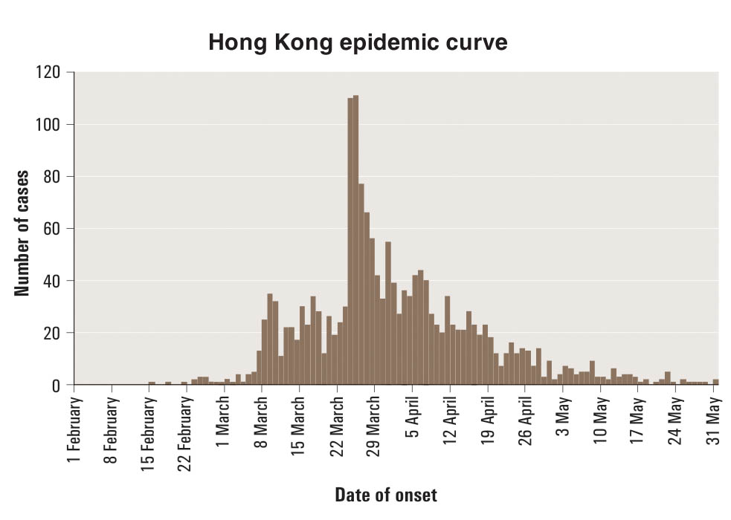
Epidemic patterns: SARS epidemic
SARS

Slide 23
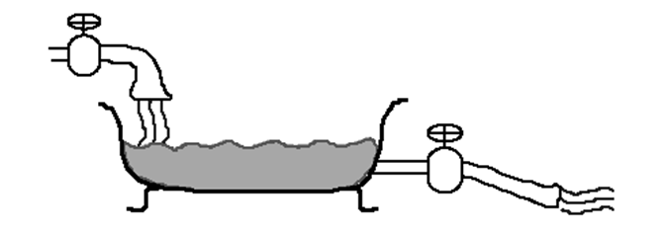
Measures of Disease Frequency
Incidence: Measures new cases of a disease that develop in a population over a period of time.
Prevalence: Measures existing cases of a disease in a population at a given time.
Incidence
Prevalence
Fatality, recovery

Slide 24
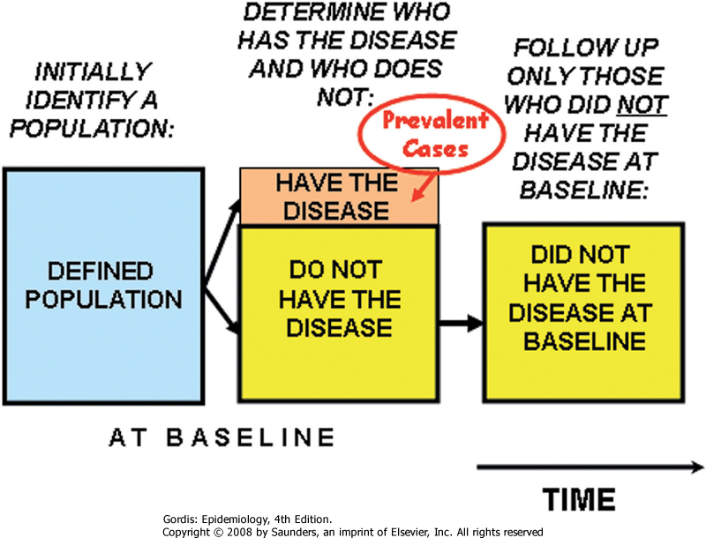
Population at risk

Slide 25
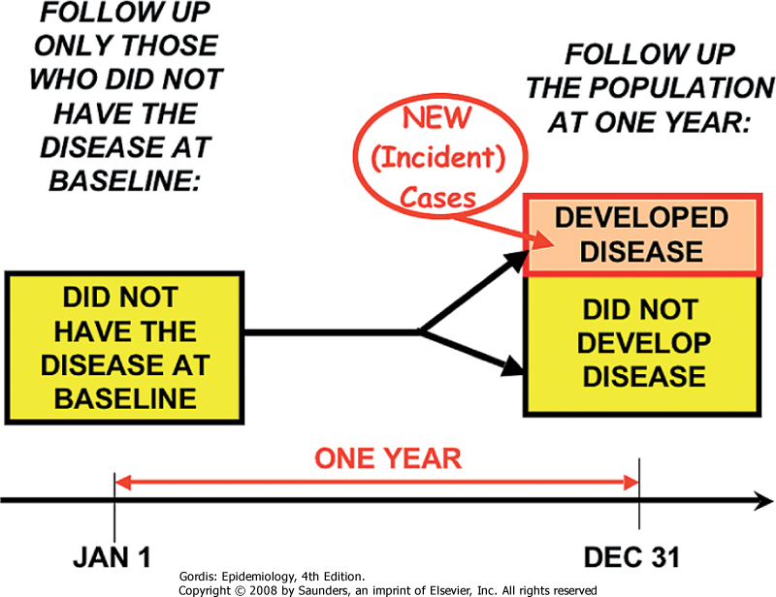
Follow-up period

Slide 26
Measures of transmissibility
Attack rate: proportion of susceptible individuals in a given setting that become infected.
Reproduction number: (average) number of successful transmission per infectious individual.

Slide 27
Basic reproduction number
Basic reproduction number (R₀):
Expected number of cases caused by a typical infectious individual in a susceptible population.
R0 ≤ 1
disease dies out
R0 > 1
disease can invade
POPULATION SPECIFIC MEASURE

Slide 28
Effective reproduction number
Transmission
No transmission
Immune
Effective reproductive number
Expected number of cases caused by a typical infectious individual
in a population that is not wholly susceptible.

Slide 29
Numerical values of the basic reproduction number and the critical vaccination proportion, pc
Scherer, A. & McLean, A. Mathematical models of vaccination. Br Med Bull 62, 187-199 (2002).

